Slide 1


Slide 2
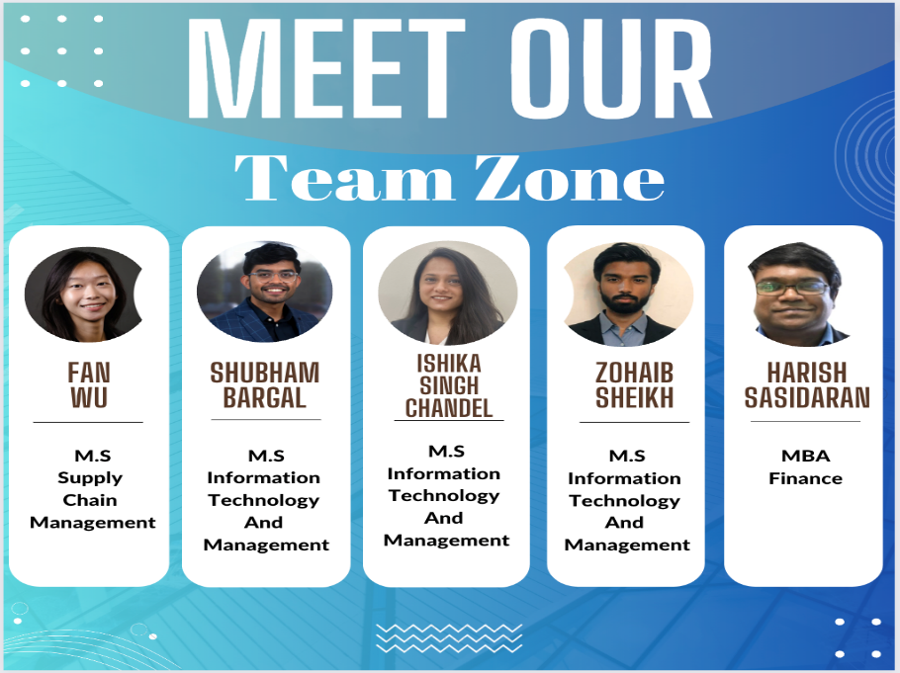

Slide 3
Table of Contents
PRODUCT DESCRIPTION
Managing and organizing sports activities will not be a ruckus anymore. Introducing Zone, the all-in-one platform designed to revolutionize the world of sports management, training & collaboration. Whether you are a player, coach, parent, team manager, club manager, or director of sports, Super Sports App has something to offer you. Few highlights of features that we offer –
Schedule matches & practices and reserve venues
Manage equipment inventory
Offers a comprehensive catalog of upcoming tournaments
Virtual reality training platform
AI-powered game analysis
Stay connected with your team through the app's in-app communication and social media integration features
Fitness tracking and dietary monitoring features to promote healthy habits, ensuring you stay at the top of your game.
With over 800+ sports worldwide, Zone caters to players of all sports. Be a part of this revolution in sports management and download our app today.
1
Vision and Mission
2
Product Roadmap
3
Innovation
4
Disruptive Innovation
5
Market Survey
6
Market Strategy
7
Value Creation and Stickiness
8
Market Types
9
Financial Information

Slide 4
VISION And MISSION
VISION
We endeavor to transform the way sports enthusiasts of all levels manage and organize their sporting activities. We aim to empower individuals and teams of all levels to achieve their full potential by providing an innovative and comprehensive platform that promotes healthy lifestyles, fosters community connections, and drives personal growth
MISSION
Revolutionize the sports industry and become the go-to platform for sports enthusiasts worldwide by offering cutting-edge features like virtual reality training, argument reality scouting, AI-powered game analysis and dietary monitoring, as well as social media integration. Our mission is to make sports management accessible, efficient, and enjoyable for everyone, so they can focus on what they love most - playing the game.

Slide 5
PRODUCT ROADMAP
Phase 1 LAUNCH (Sep 2022 – Apr 2023)
Phase 2 (May 2022 – Oct 2023)
Phase 3 (Sep 2023 – Dec 2023)
Phase 4 (Jan 2023 – May 2024)
Free Trial Promotion
Ad Monetization
Background Check: authentication
AI-generated Animated & Visual Content for learning
Scheduling venue: matches, practices
Near Me - recommends events near user location
In-app Fee Payment
Equipment Inventory Mgmt: order new equipment and assign it to players or teams
Parental Supervision (Kids Mode): parents can view anything their children are viewing
Coach Connect: players connect to expert coaches
View latest sports news
Sonia: personalized chatbot
Social Media Integration
Expansion to Texas
Collect Subscription Payments
Zone Community: social platform for players to connect based on similar interest
Wearable: health & fitness tracking through wearable device
VR Training and AI-based Motion Capture Feedback System
Augmented Reality (AR) Technology: track & analyze players during live games, provide real-time performance metrics and insights
AI Game Analysis: provide insights on player & team performance, as well as game strategies
Predictive Analytics: predict game outcomes and player performances
Virtual Coach: chatbot coach can provide users with guidance, tips, and feedback on their performance
Professional Coaching Mentorship Program: collab with Official Sporting Organizations that connects aspiring coaches and experienced coaches
Zone Marketplace: shop any sports merchandise
Kit Customization and Design
Dietary Monitoring & Recommendation
Wellness & Injury Tracking
Weather App Integration
Sports League Collab
Travel Mgmt: manage team travel with 3rd party vendors
Expansion to sunbelt region
Personalized Badges: for player accomplishments
Amateur Live Match Broadcasting
Personalized Training Programs: AI algorithms create personal programs for users based on skill level & goals
Smart Contracts: help players get brand endorsements & create a transparent and secure system for managing contracts and financial transactions between players, teams, and sponsors.
Skill Assessment
Localization of Languages
Fan Engagement: such as live Q&A sessions, autograph signing events, personalized fan merch
Upselling and Cross-selling: recommend customers upgrades, add-ons, or related products
User Feedback Survey: for continuous improvement
Notes:
Ishika & shubham
Social Media Integration Community building Professional coaching mentorship program:
One application for all management
Smart Kit customization
------
Disruptive -
VR training and AI based motion capture feedback system
Augmented Reality (AR) scouting
AI-powered game analysis
Coach Connect Smart Contract

Slide 6
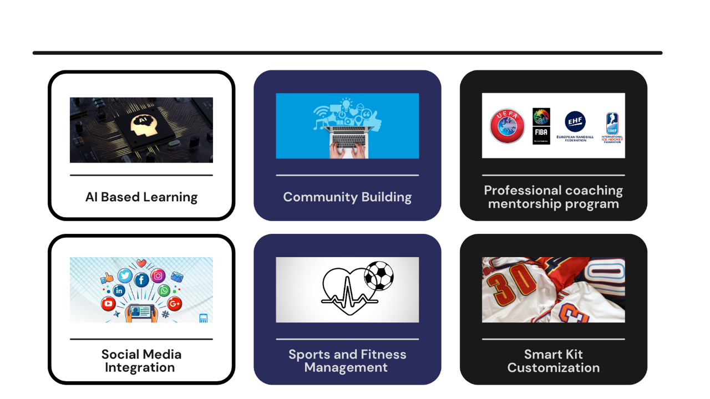
INNOVATION

Slide 7

DISRUPTIVE INNOVATION
Traditional Sports Management Applications
The Disruption
These apps may not cater to all the needs of sports organizations, professionals, and enthusiasts.
This can result in inefficiencies and difficulties for users who have to switch between multiple platforms to meet their requirements.
Using multiple apps can be time-consuming and confusing, as users have to remember different login credentials, interfaces, and features.
This can also lead to data silos and inconsistent information across different apps, making it harder to manage and analyze sports-related data effectively.
Zone is an all-encompassing ecosystem catering to the diverse needs of sports and fitness management. This comprehensive platform provides a range of some unique services and tools all under one platform :
AI-Powered Analysis
Integrating Wearables with Health & Fitness Tracking
VR Training and AI-based Motion Capture Feedback System
Smart Contracts
Coach Connect
Augmented Reality (AR) Technology
Amateur Live Match Broadcasting

Slide 8

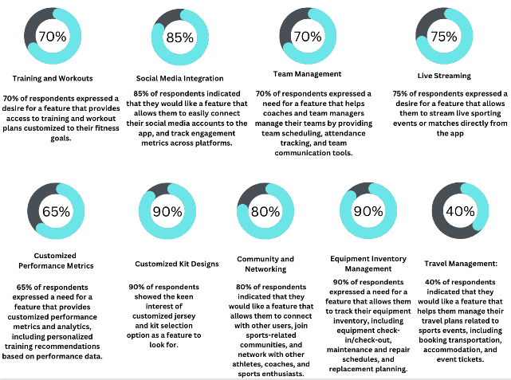
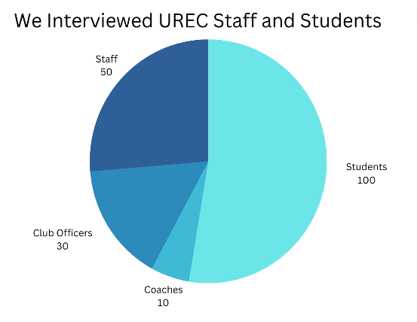
MARKET SURVEY

Slide 9
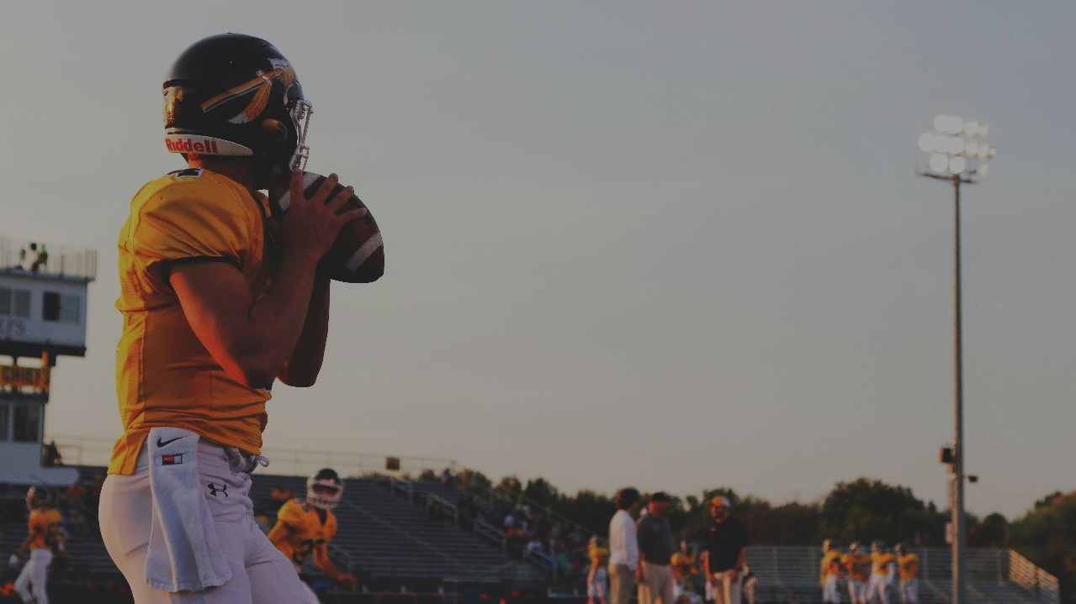
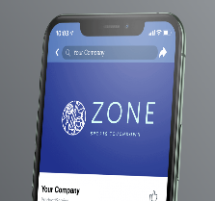


MARKETING STRATEGY
Target Market
Clubs/Teams
Universities
Enterprises
Individual
Go to Market Strategy
Promotions:
Free trial
Student plan
Referral
Marketing
Influencer Marketing
Website
Newsletter
Partnerships:
Sports Clubs
Teams
Leagues
Rewards:
Venue discounts
Tiered pricing and discount off yearly subscription
Host sports/ fitness events:
Marathons
Rock climbing
App Store Optimization (ASO)
Ads at:
Local events
Schools/Universities
Notes:
Market survey and market strategy

Slide 10








VALUE CREATION
Shareholders
Users
Employees
Rev streams
Subscription-based
Commissions
Additional fees (aftermarket)
Ad rev
Dividends
Amateur athletes
Easy learning (AI content)
Sports journey companion
Individual users
Fitness journey companion
Fan engagement
Team/club users
Digitize management
Gain exposure
Earn $$
Team building events
Support work/life balance
Fan Wu
Calories burnt 356🔥
Steps taken 215👟
Events near you
3
Vegan Snacks
Jun 18•Tue
Soccer Practice @ UTD Soccer…
Jun 22•Sat
Basketball with friends @ Plano…
June 2023
Mon
Tue
Wed
Thu
Fri
Sat
Sun
1
2
3
4
5
6
7
8
9
10
11
12
13
14
15
16
17
18
19
20
21
22
23
24
25
26
27
28
29
30
Notes:
I recommend to open in presentation mode to view animations!

Slide 11

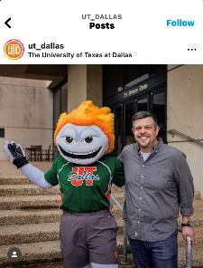




come play volley with us this fri!
yes!! what time? who’s coming?
u should download zone, it’s what we’re using to coordinate everyone
STICKINESS
oo, is it free??
ya it’s free for individual users 🥳
Create ecosystem = change consumer behavior
Integration after users ↑ = loyalty
Aftermarket = market momentum ↑
Aggressive marketing = users ↑
Low
High
we are the solution
influencer marketing
free trials
sponsor local events
event mgmt
social media
track fitness/sports data
buy merch
universities
gyms
rec centers
private lessons
connect players/teams to brand endorsements
live broadcasting
AI data analysis
Notes:
Aftermarket needs to refer to phase 4 features

Slide 12
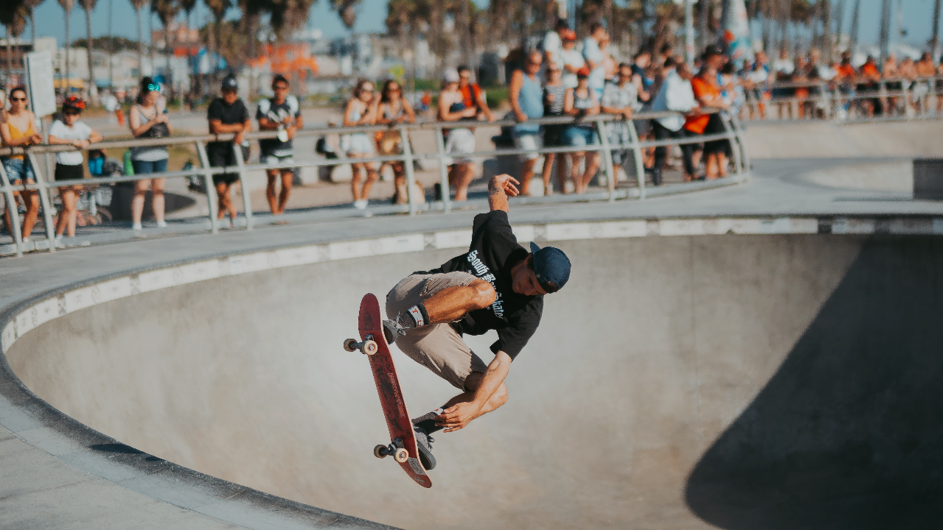





MARKET TYPES
Existing Markets
Adjacent Markets
New Market
Sports Technology
Sports Training & Coaching
Video Streaming
Travel Management
Education
AI generated content and videos
Customized Merchandise
Zone Marketplace
Physiotherapy
AI motion analysis tech applies towards physical therapy patients
VR Gaming
Sports & Fitness Management
Exponential Growth: capturing sports mgmt & fitness mgmt market

Slide 13
PRICING STRATEGY
Promotions!
Student Plan
Individual User
Enterprise
First 6 months FREE
5
$
9
$
110
$
/month
/month
/month
STU AND IND USERS
+3500 one-time set up
FREEMIUM
FREEMIUM
FREEMIUM
$60
$51/year
$108
$92/year
$1,320
$1,254/year
Start Trial
1 month FREE
19
$
19
$
198
$
/month
/month
/month
ENTERPRISES
+3500 one-time set up
PREMIUM
PREMIUM
Start Trial
FREEMIUM
$228
$199/year
$228
$199/year
$2,476
$2,257/year

Slide 14
COST ASSUMPTIONS- Prelaunch
Cost Assumptions
Founders Stipend | Split amongst 5 founders | $ 36,000.00
Developers (5) | Development period of 6 months | $ 500,000.00
Initial Hardware | High performance computers/desktops | $ 150,000.00
Rent & PPE | Lease, intangible assets | $ 98,000.00
Testing - 3rd Party | Testing requires different mobile devices with diff OS and screen sizes | $ 450,000.00
Cloud Hosting and Miscellaneous IT | Software programs, cloud storage, cloud encryption | $ 220,000.00
Pre-Launch Promotions | Website & email updates to announce app, influencer marketing | $ 400,000.00
Total |  | $ 1,450,000.00
Initial Incorporation cost and Development cost is 1,454,000, with app development cost being 60%
All core app development, marketing, and administrative expenses are inhouse ( 5 developers at 100,000 USD each per year)¹
Founders' stipend is 6000$ monthly- till the end of the stage –I or launch
Developers are for core product development and in the USA
All Testing and SQA are third-party at $50/hr for 9000hrs
Cloud computing and storage costs are based on median Amazon/ Azure cost for startups in the early phase
Rent and other PPE based on DFW commercial property rents
Notes:
fan

Slide 15
COST ASSUMPTIONS – Post Launch
Total COGS & SGNA Costs
Marketing & Sales Costs
Post-launch expenses breakdown is 33% operational and 30% sustainment costs
Marketing and Sales are 22% of the cost, with free user accounts costing 60% of marketing budget²
Notes:
Market – 5%
Ops – 26%
Hardware – 8%
Sus dev – 30%
Transaction - .8%

Slide 16
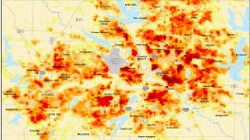
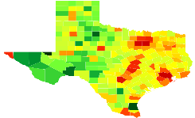
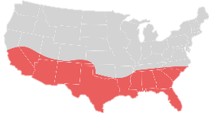
Subscriber Growth Assumptions
DFW
Individual customers – 9.4M, Enterprise 2.7K
3.4% in Schools, 0.2% retail customers, 3.5% Enterprise
Texas
Individual customers – 21M, Enterprise 8.5K
3.56% in Schools, 0.23% retail customers, 3.8% Enterprise
Su
3.7% in Schools, 0.26% retail customers, 3.9% Enterprise
Target Market
Market Share
Premium Users and CAGR
Market Size- Students Retail- Enterprise
6%, 4.6%
7%, 4.8%
7.3%, 5.1%
Individual customers – 255M, Enterprise 101K
School+ Retail Users+ Enterprises
Stage -I DFW
Stage –II Texas
Stage -III Sunbelt States

Slide 17
REVENUE ASSUMPTIONS
Revenue Assumptions
Student | Capturing 145,000 users/1,538,000 total market | $140,690.00
Fitness & Sports Mgmt | Capturing 51,988 users/3,239,000 total market | $2,706,585.00
One Time Cost - Enterprise | Capturing 5118 enterprises/452,243 total market | $117,600.00
Small Companies | Capturing 972 small companies/59,000 total market | $36,601.00
Retail (Individual) Customers | Capturing 133,983 users/900,507 total market | $1,205,847.00
Total |  | $5,657,323.00
Total Revenue $5,657,323.00 = 3% initial uptake in DFW market
Notes:
hs

Slide 18
ROI
Breakeven in Year 2.3
IRR = 32%
ROI = 3.07X
Fitness & Sports Management = 64% of Total Revenue
Notes:
Ishika

Slide 19
AFTER MARKET STRATEGY
Upselling and Cross-Selling: Offer premium features & package to current users or cross-sell products or service such as merchandise or tickets
Personalization: Use data analytics to personalize the user experience, by offering them game feedback and analysis, personalized training program, badges skill assessment
Partnerships & Collaborations: Collaborate with relevant sports organizations, sponsors, brands to promote the platform & offer added value to users
Subscription Model: Offer a yearly subscription for access to premium features, content, or support for all users
Affiliate Marketing: Establish partnerships with sports-related companies and offer affiliate marketing opportunities to players to allow users to earn commission
Sponsorship and Advertising: Offer sponsorship & advertising opportunities to sports-related companies looking to reach a targeted audience.
Additionally, help players get brand endorsements
Loyalty Program: Reward repeat customers with exclusive perks, such as early access to new features or discounts on future purchase, vouchers for store marketplace
Travel Management: Handle players traveling & accommodation services, such as booking flights, hotels, and rental cars.

Slide 20
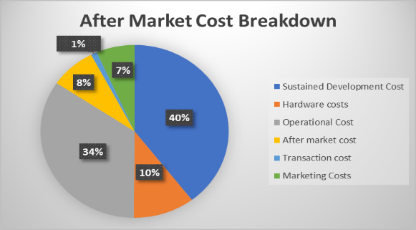
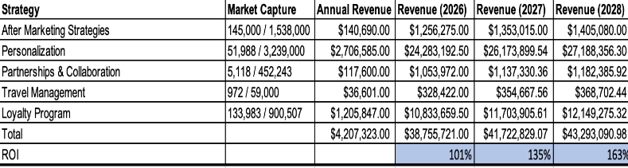
AFTERMARKET ROI
Notes:
Features that help gain rev in aftermarket
Aftermarket strategy points 2026 April - 121,192,126 2027 April - 130,523,667
2028 April - 135,091,995

Slide 21


Let’s get to know you better…
Thank you for your time!
How do you normally interact with sports?
Your interface has been customized to include:
✅ fitness tracking
✅ “near me” enabled for Dallas, Texas
✅ team management
THANK YOU
I play professionally
Reach our Zone Product Managers at:
✉️ zone.sportsjourney@zone.com
☎️ 800-319-7853
Questions?
I play frequently
Click here to sign up for the student plan!
I play very little

Slide 22
References
https://www.dallaschamber.org/wp-content/uploads/2023/03/EDG2023_BusinessEconomy-SmallBusiness.pdf
https://www.ibisworld.com/industry-statistics/number-of-businesses/gym-health-fitness-clubs-unitedstates/#:~:text=California%20(14%2C945%20businesses)%2C%20Texas,Clubs%20businesses%20in%20the%20US.
https://www.weareteachers.com/how-many-schools-are-in-the-us/#:~:text=How%20many%20schools%20are%20there,school%20for%20every%202%2C881%20people.
https://admissionsight.com/how-many-universities-are-in-the-us/#:~:text=Students%20have%20an%20abundance%20of,arts%20colleges%20to%20vocational%20schools.
U.S. Census Bureau's County Business Patterns data from 2018
https://www.infoplease.com/us/census/texas/demographic-statistics
https://finance.yahoo.com/news/global-sports-management-software-market-160000516.html?guccounter=1&guce_referrer=aHR0cHM6Ly93d3cuZ29vZ2xlLmNvbS8&guce_referrer_sig=AQAAAD6JFjL6H0KOXuo9I4y8gu0eROiu4e5xK82kyjBQeYNGN3c-BWbtaoUlBWMYzBmmXx3VbIsqaFQlY1aFHnf3q2huZktflktS5OPnQ_gftsuWvNYSc-tn_fmeiOJ6kK62EdFw0d3QBMkYohQ9Vub4qA5bXMGe_bgtJtpV7S-tDbwW
https://blog.hubspot.com/sales/gtm-strategy
https://www.business.com/articles/5-aggressive-marketing-strategies-for-startups-in-any-industry/
https://www.google.com/url?sa=t&rct=j&q=&esrc=s&source=web&cd=&cad=rja&uact=8&ved=2ahUKEwiJ6YXNtdD-AhUSl2oFHcmMCkgQFnoECBMQAw&url=https%3A%2F%2Fdatausa.io%2Fprofile%2Fgeo%2Fdallas-fort-worth-arlington-tx%23%3A~%3Atext%3DIn%25202020%2520there%2520were%2520373%252C198%2C%2525%2520men%2520and%252059.6%2525%2520women.&usg=AOvVaw1NxkCBOaC1-bRIkU4XMoRj
https://www.google.com/url?sa=t&rct=j&q=&esrc=s&source=web&cd=&cad=rja&uact=8&ved=2ahUKEwiPkd_htdD-AhUEk2oFHc5-CVsQFnoECBMQAw&url=https%3A%2F%2Fwww.collegetuitioncompare.com%2Fcompare%2Ftables%2F%3Fstate%3Dtx%26city%3Ddallas%26factor%3Dstudent-population%23%3A~%3Atext%3DThe%2520total%2520student%2520population%2520of%2C9.51%2525(9%252C342%2520graduate%2520students).&usg=AOvVaw2voZto_IAq-32KzYgSPFym
https://www.statista.com/statistics/189562/daily-engagement-of-the-us-poppulation-in-sports-and-exercise/#:~:text=Percentage%20of%20U.S.%20population%20engaged,exercise%20per%20day%202010%2D2021&text=In%202021%2C%20it%20was%20found,only%2019.6%20percent%20of%20women.
https://www.dallasecodev.org/296/Business-Environment#:~:text=Over%2065%2C000%20businesses%20call%20the,businesses%20offer%20numerous%20employment%20opportunities.
https://www.google.com/url?sa=t&rct=j&q=&esrc=s&source=web&cd=&cad=rja&uact=8&ved=2ahUKEwix0pjT6-H-AhV7k2oFHa7JANMQFnoECBEQAQ&url=https%3A%2F%2Fsensortower.com%2Fblog%2Fq1-2020-data-digest&usg=AOvVaw2j0DmvoJAwZ0nFQRG4jd0h

Slide 23
Appendix- Cost Models
Initial Starting Cost ( Table-1)
Founders Stipend | $ 36,000.00
Developers (5) | $ 500,000.00
Initial Hardware | $ 150,000.00
Rent & PPE | $ 98,000.00
Testing- 3rd Party | $ 450,000.00
Cloud Hosting and Miscellaneous IT charge | $ 220,000.00
 | Cost Growth Assumptions Table 2
 | Sustained Development Cost | 30%
 | Hardware costs | 8%
 | Operational Cost | 33.00%
 | After market cost | 6.00%
 | Transaction cost | 1%
Sales and MKT Cost | Free Account Costs | 13%
 | Online Advertising & Search Engine optimization cost | 3%
 | Bulk Discount costs | 2%
 | Tier Exchange cost | 2%
 | Brand Publishing (Tradeshow and other Media costs) | 1%
 | Social Media | 0.5%
 | Training | 0.5%
Founders stipend is 6000$ monthly- till the end of the stage –I or launch
Developers are for core product development and in the USA
All Testing and SQA are third-party at 50$ / hr for 9000hrs
Cloud computing and storage costs are based on median Amazon/ Azure cost for startups in the early phase
Rent and other PPE based on DFW commercial property rents

Slide 24
Appendix- Subscriber Growth Models
Subscriber |  |  |  |  |  |  |  | 1.194052297
Monthly |  | Initial | Recurring | Total
 |  |  |  | DFW | Texas | Sunbelt Region | United states | Initial Uptake | Growth Rate | User factor for sports
Students |  |  |  | 145,000.00 | 5,156,972 | 33,000,000 | 49,500,000.00 | 3%
Potential users |  |  |  | 9,132,079 | 16879396 | 222,191,705 | 333,287,557.00 | 0.20% | 8.00% | 5%
B2B |  |  |  | DFW | Texas |  | US
School +Colleges |  |  |  | 355 | 8161 | 79717 | 119576 | 4% | 12% | 3%
Institution/ Sports club |  |  |  | 2117.75 | 8471 | 27460 | 41190 | 3% | 3.5%
Fitness Management |  |  |  |  |  |  |  | 3.8% | 4.2%
Founders stipend is 6000$ monthly- till the end of the stage –I or launch
Developers are for core product development and in the USA
All Testing and SQA are third-party at $50/hr for 9000hrs
Cloud computing and storage costs are based on median Amazon/ Azure cost for startups in the early phase
Rent and other PPE based on DFW commercial property rents

